Slide 1

Savoury Calculator
By Uzair Sarvan(92122433)
GitHub Repo: https://github.com/IamCosima/savoury

Slide 2
The purpose of the web app
The purpose of my Savoury calculator is to allow the user to calculate a basic savoury platter or make there own platters. They can also just leave the platter making and just calculate a once off platter. Platters can only be saved when they are registered and logged in. The user created platters are only available to those that are logged in and those that are not logged in can only use the default platters and making a custom one by hand.

Slide 3

Architecture diagram
Server/Host(Backend)
Frontend
Collect data
Request Data
Display data
User
Respond Data
Contains the App logic in the Vue.js components
What the user interacts and sees with:
JavaScript(Vue.js), CSS(Tailwind CSS) and Html
Read Data
File System:
With images, HTML and CSS(Tailwind)
Read Data
Save Data
Database(Firebase)
Storing the Authentication data(email, password, UID)
Storing the data from calculator(Number and price of each savoury and the name of platter)

Slide 4
Overview of technology choices
Front-end | Back-end
Tailwind(A utility-first CSS framework) This is to allow for my css to be used in the vue components and allow for my styling to be for that particular component | Google Firebase(Database and Authentication framework) This allows me to easily set up my backend to store data and retrieve data with minimal lag and also set authentication services that allow for permissions in place.
Vue.js (framework for building web user interfaces.) This allows be to make reusable components that can dynamically show to the user if they meet a criteria that I set

Slide 5
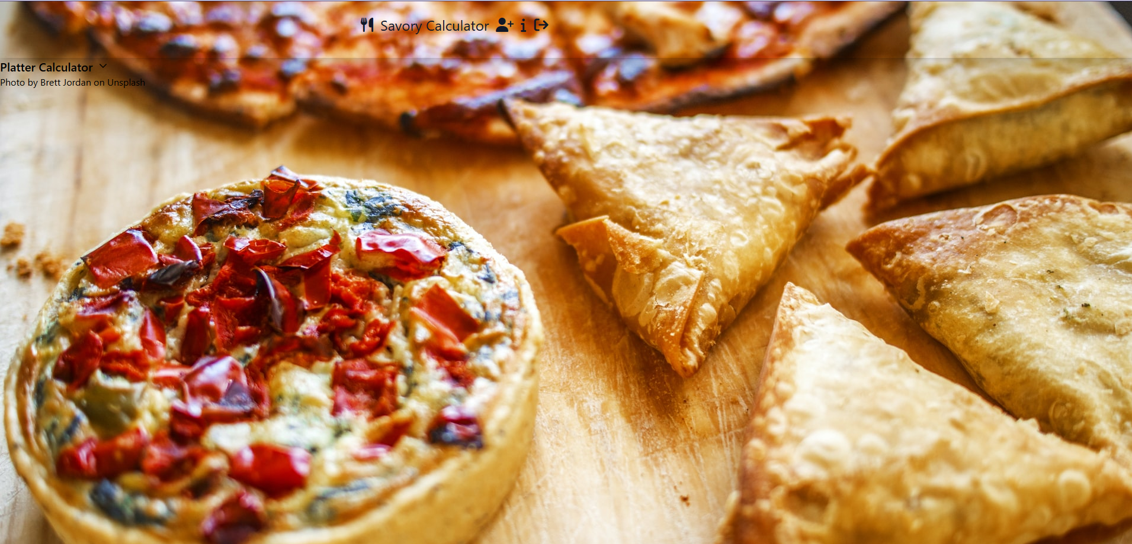
Annotated screenshots of My web application homepage
This is the calculator that can be accessed by pressing on the arrow
Login/Logout depending if you are already logged in
Registration page
This is the home page of the website

Slide 6
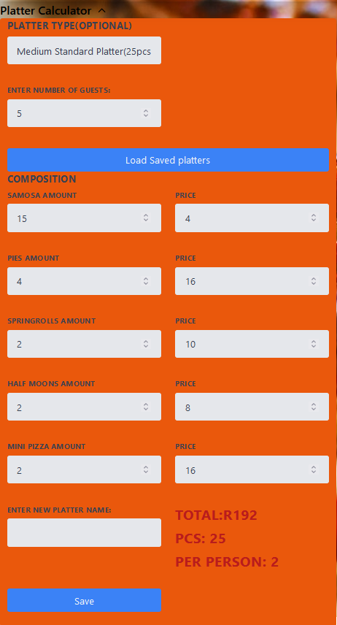
Platter Calculator Annotated screenshots
This button Loads the saved platter from the database from anyone that submitted.
This drop down box shows all the saved default platters as well as the loaded platers when Load saved platters is clicked
This is where you input the number of guests this platter is for which will be used in the per person calculation
The total price and the number of pieces of the platter is automatically calculated as you input all the values in the respective inputs.
As well as the number of savouries per a person for this platter
The save button saves the all the current data that is in the calculator as assigns it a name by the new platter name of your choosing

Slide 7
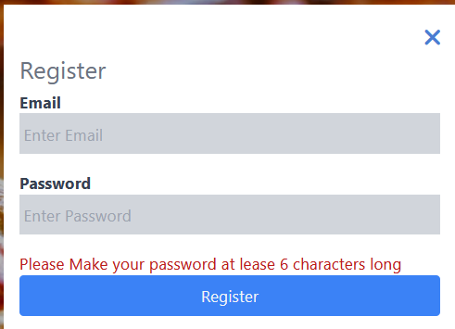
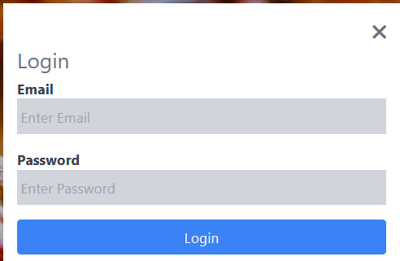
Login and Register dialogs
The x button closes the modal.
Enter the necessary inputs in the text fields bellow and press register button to register for the program
Enter the necessary inputs in the text fields bellow and press Login button to login for the program. If you made any errors in you login the necessary error code will be shown

Slide 8
Changes compared to Phase 1
Phase 1 | Phase 2
Graphing component | The graphing component has been removed as it does not work for the current iteration of the project
Custom profile icon API | The custom profile icon API as this did not fit the style of the project.
Storing Pre-set data | I also changed what kind of data I am storing and making it to that all users can access custom platters no matter if they are logged in or not and it saves into a more public accessible database
Price per person : | As this does not fit in the current iteration of the project which is more focused on the total cost and how many a person receives from a platter

Slide 9
Bibliography(For images)
https://www.iconspng.com/image/90490/mobile-displays-against-a-computer-screen

Slide 10
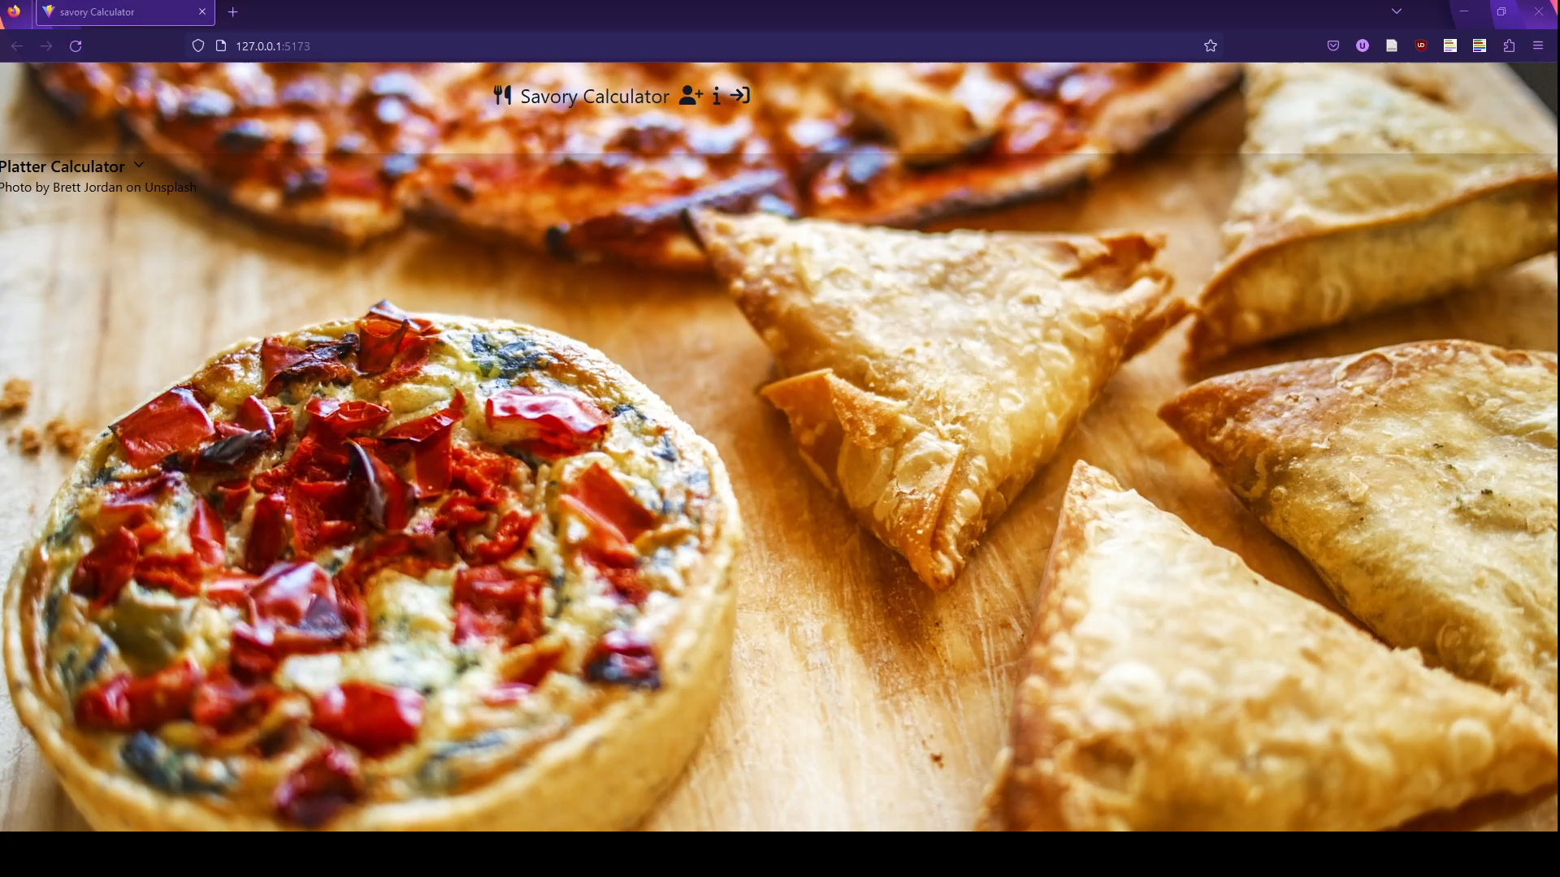
1-2min screencast showing the current state

